Slide 1

Digital Control System- Final Presentation
Project Name:
Digital Control System
Project Number:
2692
Students:
Ronen Dvorkin 315203539
Omri Meron 316384981
Instructor:
Meir Alon
Lab:
Projects Lab- Tel-Aviv University

Slide 2
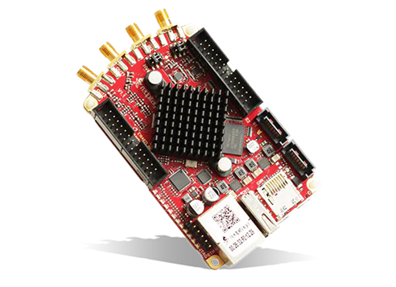
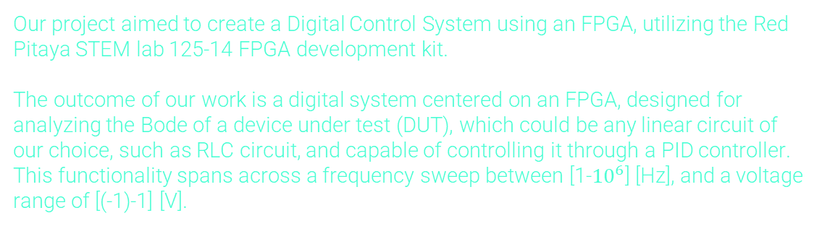
Abstract
Our project aimed to create a Digital Control System using an FPGA, utilizing the Red Pitaya STEM lab 125-14 FPGA development kit.
The outcome of our work is a digital system centered on an FPGA, designed for analyzing the Bode of a device under test (DUT), which could be any linear circuit of our choice, such as RLC circuit, and capable of controlling it through a PID controller. This functionality spans across a frequency sweep between [1-${10}^{6}$] [Hz], and a voltage range of [(-1)-1] [V].

Slide 3
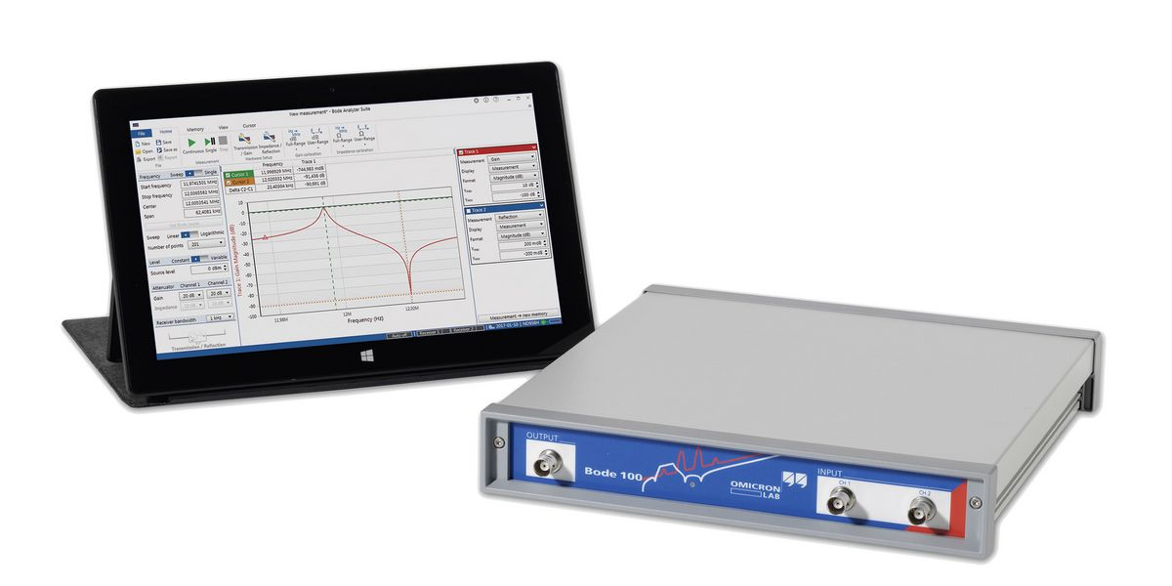
Motivation & Goals
The significance of control systems extends to various sectors including medicine, military applications, and other areas reliant on electronically controlled systems.
Goals:
Designing the system on an integrated FPGA board resulting in lower cost and area, relative to other existing systems
Omicron Lab-Bode Analyzer
Gain expertise in the digital systems domain, particularly focusing on FPGA technology and Verilog programming

Slide 4
System Requirements
Input Frequency Range:
1 [Hz] – 1 [MHz]
Red Pitaya’s Specifications:
Input/Output Amplitude Range:
Input’s Bandwidth = 0-60 [MHz]
Output’s Bandwidth = 0-50 [MHz]
Output’s Voltage Amplitude = 2 [Vpp]
ADC/DAC- 14 [Bits]
-1 [V] – 1 [V]
14 [Bits]
Bode Analyzing Accuracy:

Slide 5
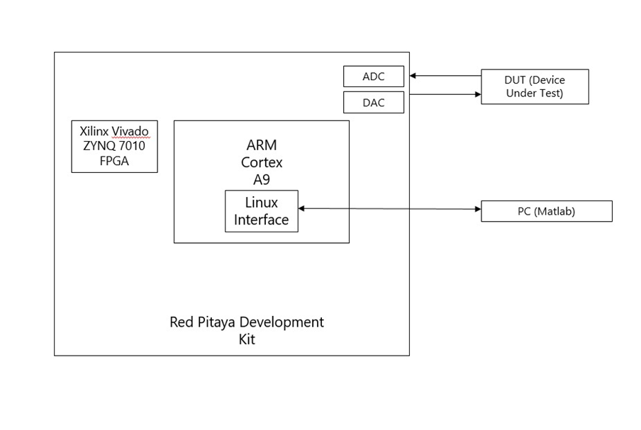
Implementation

Slide 6
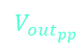
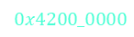

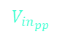
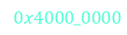

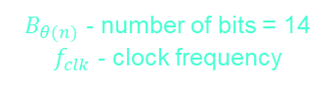

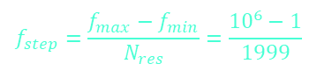

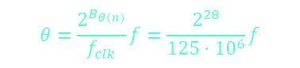
Implementation- FPGA Part
θ_data
DDS Compiler
DAC
DUT
$$θ$$
$$\text{samples}\text{_}\text{data}$$
$$f_{step}=\frac{f_{max}−f_{min}}{N_{res}}=\frac{{10}^{6}−1}{1999}$$
Max-Min calculator
BRAM
$$V_{in_{pp}}$$
$$0x4000_0000$$
$$θ=\frac{2^{B_{θ(n)}}}{f_{clk}}f=\frac{2^{28}}{125⋅{10}^{6}}f$$
$B_{θ(n)}$ - number of bits = 14 $f_{clk}$ - clock frequency
$$t_{p}$$
BRAM
Max-Min calculator
ADC
$$0x4200_0000$$
$$V_{out_{pp}}$$
filtered $\text{samples}\text{_}\text{data}$

Slide 7
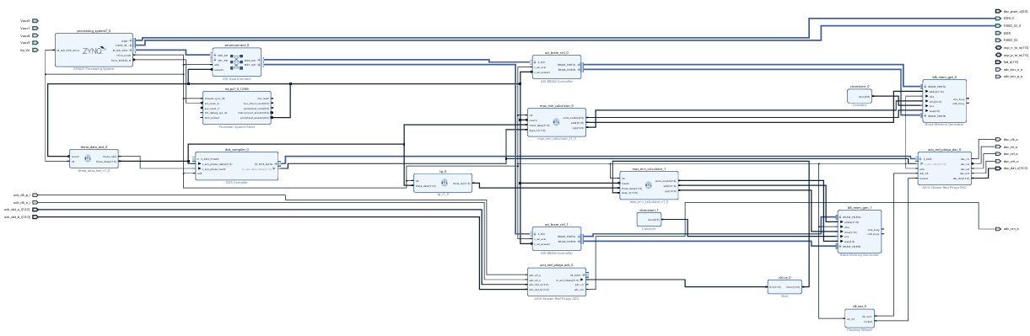
Implementation- FPGA Part

Slide 8
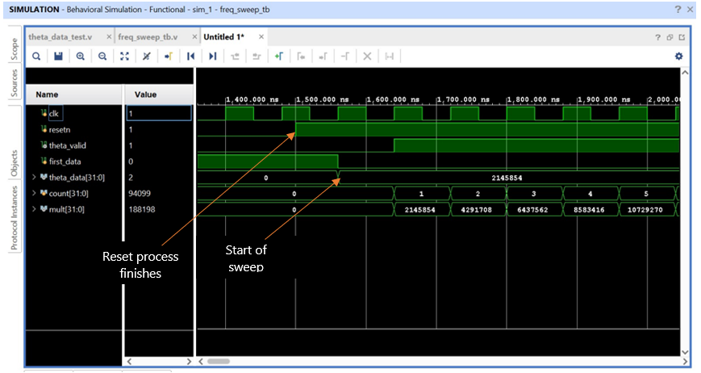

Implementation- $theta_data$ Simulation
The next simulation shows the beginning of the sweep, using the counter to count the clock cycles until advancing the $θ$ value (meaning advancing to the next frequency).

Slide 9
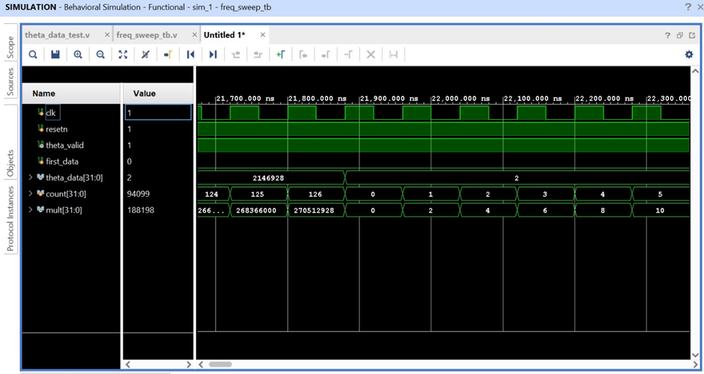
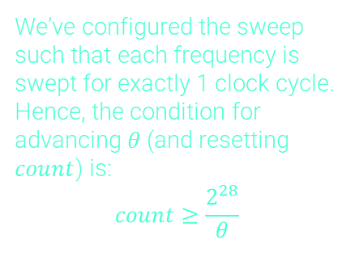
Implementation- $theta_data$ Simulation
When the maximum frequency of ($1 [MHz]$) is reached, the value of $θ$ is initialized and the sweep begins again:
We’ve configured the sweep such that each frequency is swept for exactly 1 clock cycle. Hence, the condition for advancing $θ$ (and resetting $count$) is:
$$count≥\frac{2^{28}}{θ}$$

Slide 10
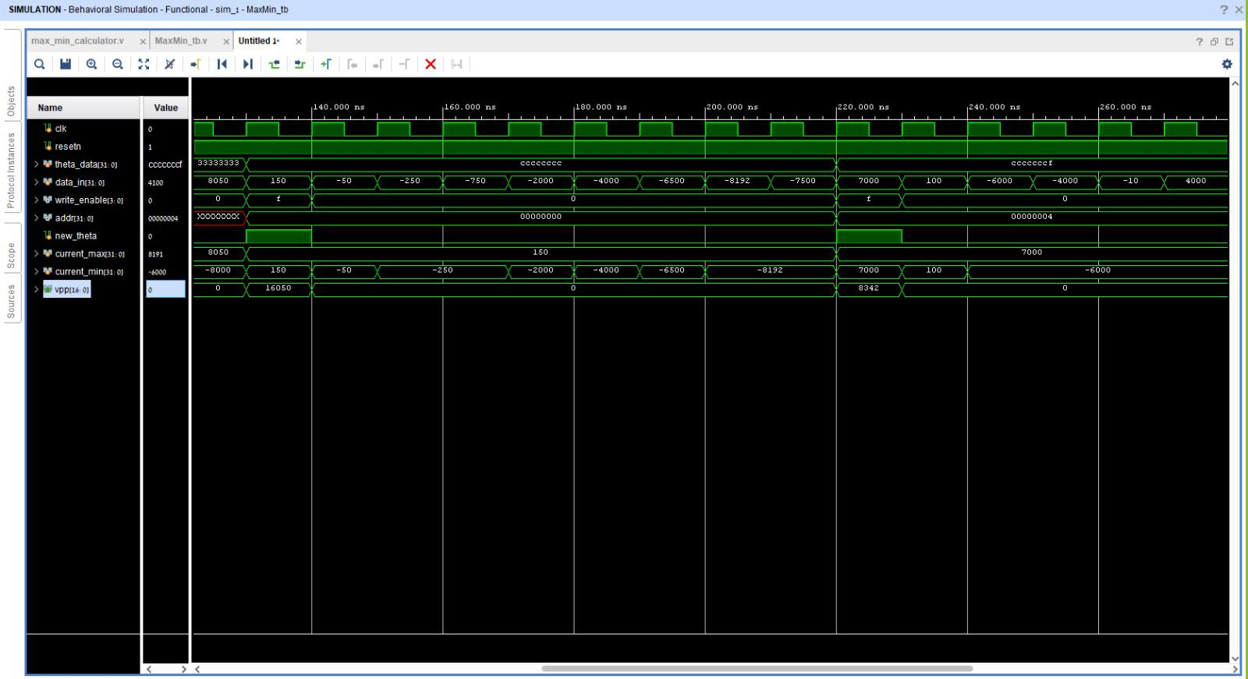
Implementation- $max⁡_min⁡_calculator$Simulation

Slide 11
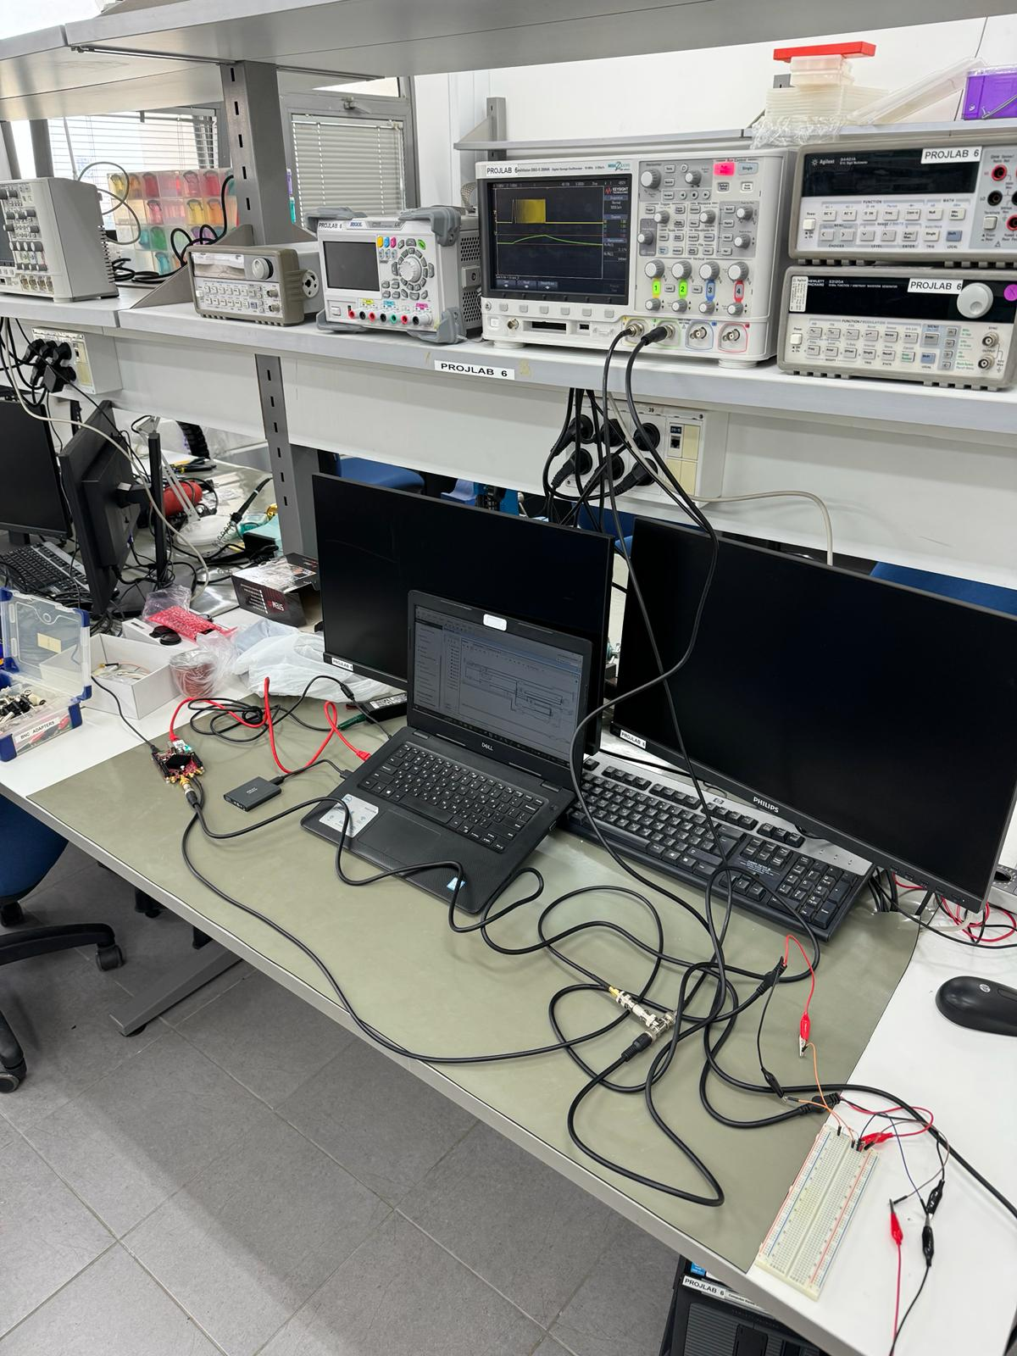
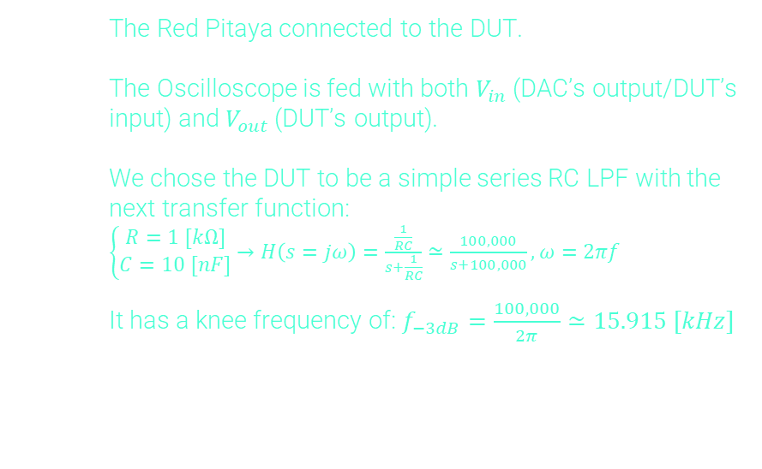
Demonstration
The Red Pitaya connected to the DUT.
The Oscilloscope is fed with both $V_{in}$ (DAC’s output/DUT’s input) and $V_{out}$ (DUT’s output).
We chose the DUT to be a simple series RC LPF with the next transfer function:
$\left\{\begin{matrix}R=1 [kΩ] \\ C=10 [nF]\end{matrix}→H\left(s=jω\right)=\frac{\frac{1}{RC}}{s+\frac{1}{RC}}≃\frac{100,000}{s+100,000},ω=2πf\right.$
It has a knee frequency of: $f_{−3dB}=\frac{100,000}{2π}≃15.915 [kHz]$

Slide 12
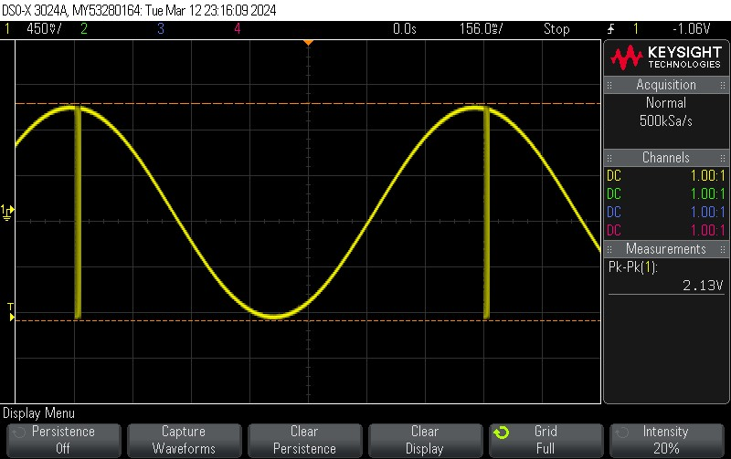
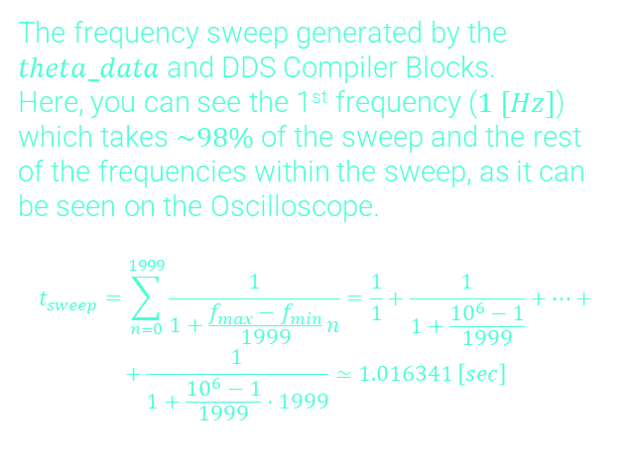
Demonstration
The frequency sweep generated by the $theta_data$ and DDS Compiler Blocks.
Here, you can see the 1st frequency ($1 [Hz]$) which takes $\sim 98\%$ of the sweep and the rest of the frequencies within the sweep, as it can be seen on the Oscilloscope.
$$t_{sweep}=\sum_{n=0}^{1999}{\frac{1}{1+\frac{f_{max}−f_{min}}{1999}n}=\frac{1}{1}+\frac{1}{1+\frac{{10}^{6}−1}{1999}}+…+}$$
$$+\frac{1}{1+\frac{{10}^{6}−1}{1999}⋅1999}≃1.016341 \left[sec\right]$$

Slide 13
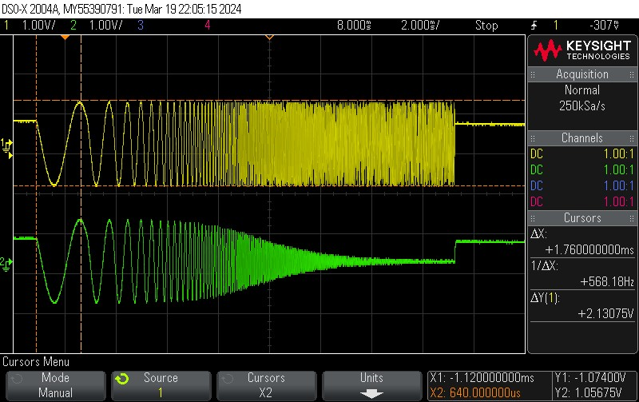
Demonstration
Output of the DUT
Smaller frequencies pass the filter, larger frequencies are filtered out.

Slide 14
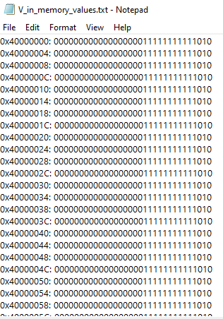
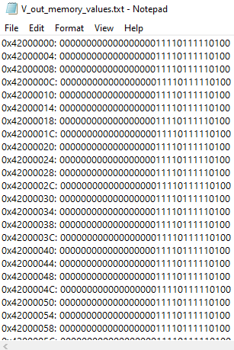
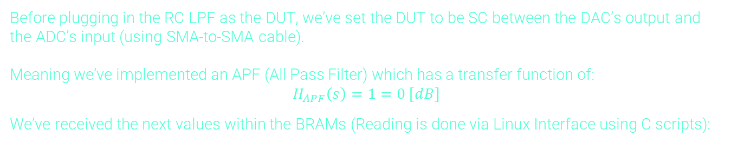
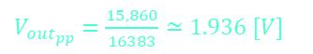
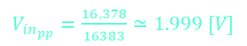
Results
Before plugging in the RC LPF as the DUT, we’ve set the DUT to be SC between the DAC’s output and the ADC’s input (using SMA-to-SMA cable).
Meaning we’ve implemented an APF (All Pass Filter) which has a transfer function of:
$$H_{APF}\left(s\right)=1=0 [dB]$$
We’ve received the next values within the BRAMs (Reading is done via Linux Interface using C scripts):
$V_{in_{pp}}=\frac{16,378}{16383}≃1.999 [V]$
$V_{{out}_{pp}}=\frac{15,860}{16383}≃1.936 [V]$

Slide 15
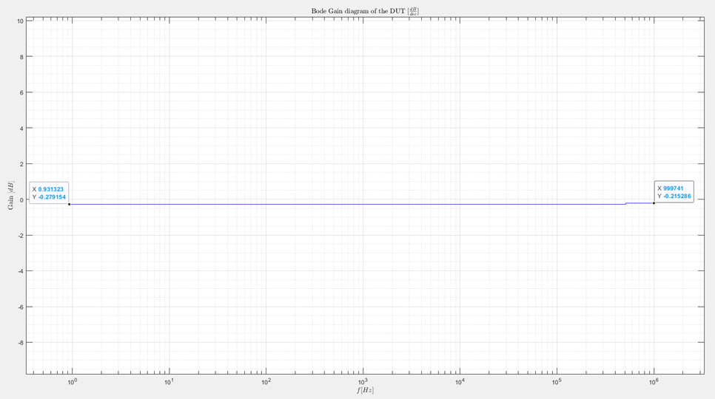

Results
Applying these results in MATLAB, where we’ve calculated the gain as:
$$gain_{dB}=20\log_{10}\left(\frac{V_{out_{pp}}}{V_{in_{pp}}}\right)$$
We’ve received the next Bode Gain diagram:

Slide 16
Conclusions
The frequency sweep performs as intended.
BRAM Reading & Writing operations works as intended.
The sweeping time is optimized
The frequency sweep resolution is constant (2000 frequencies).
The peak-to-peak calculation works as intended.
Using Red Pitaya’s DAC & ADC saves time and money.
The sweeping time is optimized
The system works as expected for basic SC Load.

Slide 17
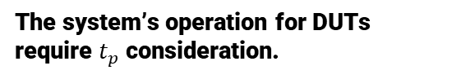
Conclusions
The system’s operation for DUTs require $t_{p}$ consideration.
Understanding the DUT's implementation and parameters is necessary for this consideration.

Slide 18
Suggestion for Project’s Continuation
Resolving the propagation delay issue by:
Implementing a block that calculates the propagation delay of the DUT.
Reimplementing the peak-to-peak calculation of the output signal such that it won’t need to take the propagation delay into account.
Implementing a Phase Shift Detector and adding it to this project in order to have a complete Bode Analysis System.

Slide 19
Suggestion for Project’s Continuation
Implementing the system with a changing sweeping limit while maintaining the same 2000 steps within the sweep.
Implementing a system that doesn't rely on the DDS Compiler.

Slide 20
Project Documentation
GIT Repository:
Github- Digital Control System

